Slide 1

Employee Management System

Slide 2

Self Introduction
Name = Vedika Yuvraj Warke
Qualification = B.E (AI & DS)
Why I am in Data Science = I want to be in data science because I enjoy solving puzzles using data. It is exciting to see how a few lines of code can uncover insights that help a business succed.
Work experience = Fresher

Slide 3
Agenda
Real World Context
Dataset Source
Objective
Why a Relational Database is Needed
ER Diagram and schema explanation
Key analysis questions (use cases)
SQL query results with screenshots or summaries
Final business insights and recommendations
Conclusion (Key finding overall)
Q&A Slide
Your Experience/Challenges working on SQL – Data Analysis Project.

Slide 4
Real World Context
This project represents a Human Resource & Payroll Management System used in organizations to manage:
Employee personal details
Job roles and departments
Salary, bonuses, and payroll records
Employee qualifications
Leave management

Slide 5
Dataset Source
The dataset used in this project is self-created. It is manually designed based on real-world HR and payroll system requirements to simulate employee, department, salary, leave, and payroll data for learning and analysis purposes.

Slide 6
Objective
To design a relational database system that:
Stores employee and job details efficiently
Automates payroll calculations
Tracks leave and qualifications
Supports accurate reporting and analysis

Slide 7
Why a Relational Database is Needed
It keeps the data accurate and consistent by using relationships (foreign keys), so wrong or mismatched data is not stored.
The same data does not have to be entered again and again, which reduces duplication and saves storage space.
It allows us to retrieve meaningful information easily by combining data from multiple tables using JOIN operations.
The database is easy to manage, update, and expand as the organization grows

Slide 8
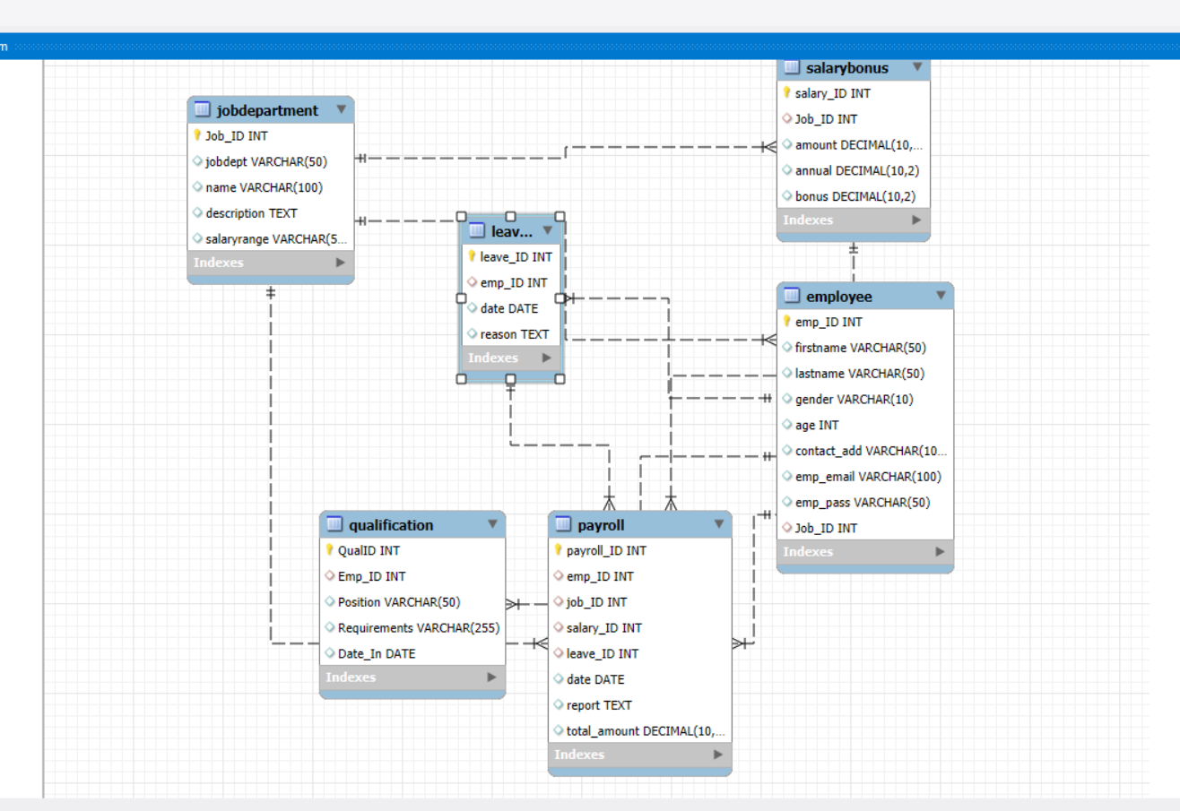

Slide 9
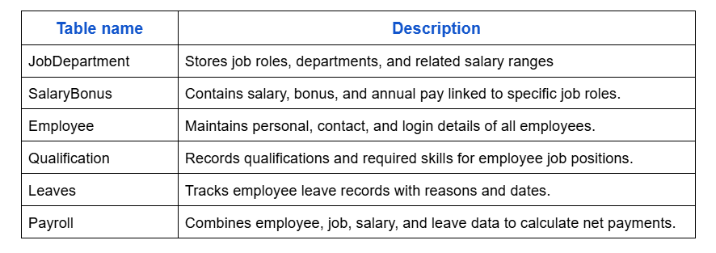
Data Description

Slide 10
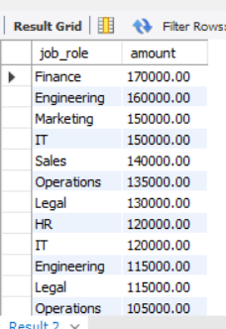
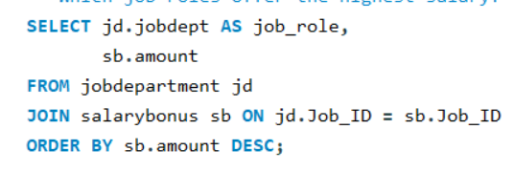


Key analysis questions
Which job roles offer the highest salary?
How many employees have at least one qualification listed?

Slide 11
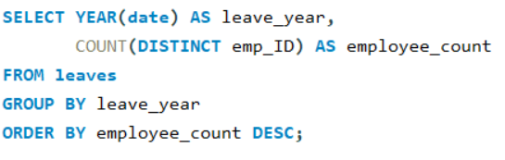

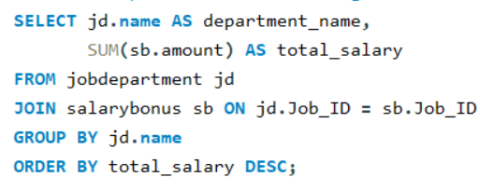
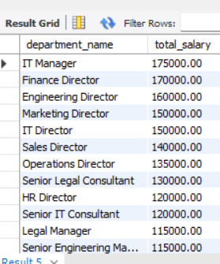
Which year had the most employees taking leaves?
Which departments have the highest total salary allocation?

Slide 12
Business Insights
Departments with more employees spend more on salaries, which helps management plan the budget properly.
Employees with better job positions and qualifications get higher salaries and bonuses.
Employee leaves affect salary calculation, so tracking attendance is important.
Payroll data helps HR find the highest-paid employees and keep salaries fair.
Keeping all employee data in one system makes work faster and decisions easier.

Slide 13
Conclusion
The Employee Payroll Management System:
Improves accuracy and efficiency
Reduces redundancy
Enables quick decision-making
Reflects real-world HR operations
This database design is scalable, secure, and industry-relevant, making it suitable for real organizational use.

Slide 14
Your Experience/Challenges working on SQL
Working on this SQL data analysis project was a valuable learning experience. I learned how to design relational tables, write SQL queries, and analyze data to answer real business questions.
Challenges Faced
Understanding relationships between multiple tables
Writing complex JOIN queries
Handling foreign keys and data consistency
Converting business questions into SQL queries
How I Overcame Them
Practiced ER diagrams before writing queries
Used step-by-step query building
Tested queries with sample data
Referred to documentation and examples

Slide 15

THANK YOU

